Slide 1
Weekend hack
Since we are stuck at home, why not

Slide 2
Genetic algorithms
procedure genetic_algorithm {
set time t = 0;
initialize the population, P(t);
while the termination condition is not met do {
evaluate the fitness of each member of P(t);
select most fit members from P(t);
produce the offspring of pairs of members using genetic operator;
replace the weakest candidates of P(t) with these offspring;
set time t = t + 1;
}
}
Genetic algorithms are based on the evolutionary model: a population of individuals is shaped through survival of its fittest members.

Slide 3

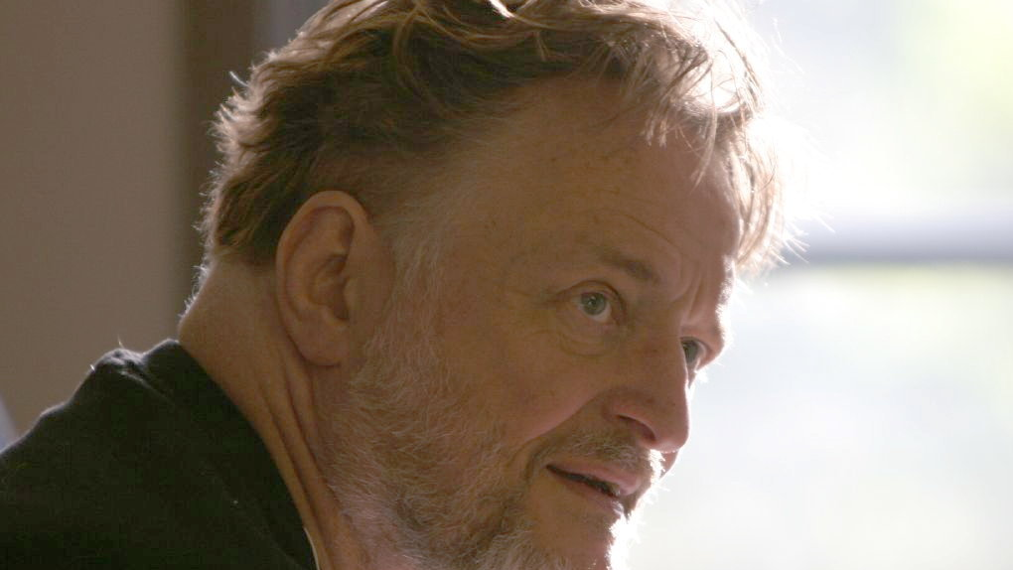
John Conway
An English mathematician
Finite groups, knot theory, number theory, combinatorial game theory, coding theory…
Cambridge and Princeton
Inventor of cellular automaton called GAME OF LIFE
26-12-1937 to 11-04-202

Slide 4
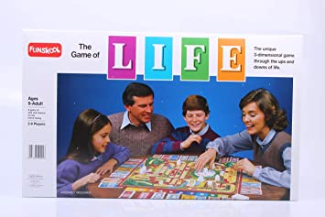
Game of life
Not this one

Slide 5
Game of life
This one

Slide 6
What is it?
Game of life is a cellular automaton.
It is a zero player game.
Evolution is determined by initial state

Slide 7
Rules
The universe of the Game of Life is an infinite, two-dimensional orthogonal grid of square cells, each of which is in one of two possible states, live or dead
Every cell interacts with its eight neighbours, which are the cells that are horizontally, vertically, or diagonally adjacent.
At each step in time, the following transitions occur:
Any live cell with fewer than two live neighbours dies, as if by underpopulation.
Any live cell with two or three live neighbours lives on to the next generation.
Any live cell with more than three live neighbours dies, as if by overpopulation.
Any dead cell with exactly three live neighbours becomes a live cell, as if by reproduction.

Slide 8
Can you write a program implementing these rules?
Input to your program is an initial state.
You program then shows evolution based on the rules mentioned previously.

Slide 9
Rules and regulations
Time is precious, no extra time apart from that allocated.
You can use any programming language (anything below C’s level gives us headache understanding it).
Internet is an awesome resource, use it.
Cheating is NOT frowned upon, provided you understand what you did.

Slide 10
Happy hunting ☺
Any questions?

